Slide 1
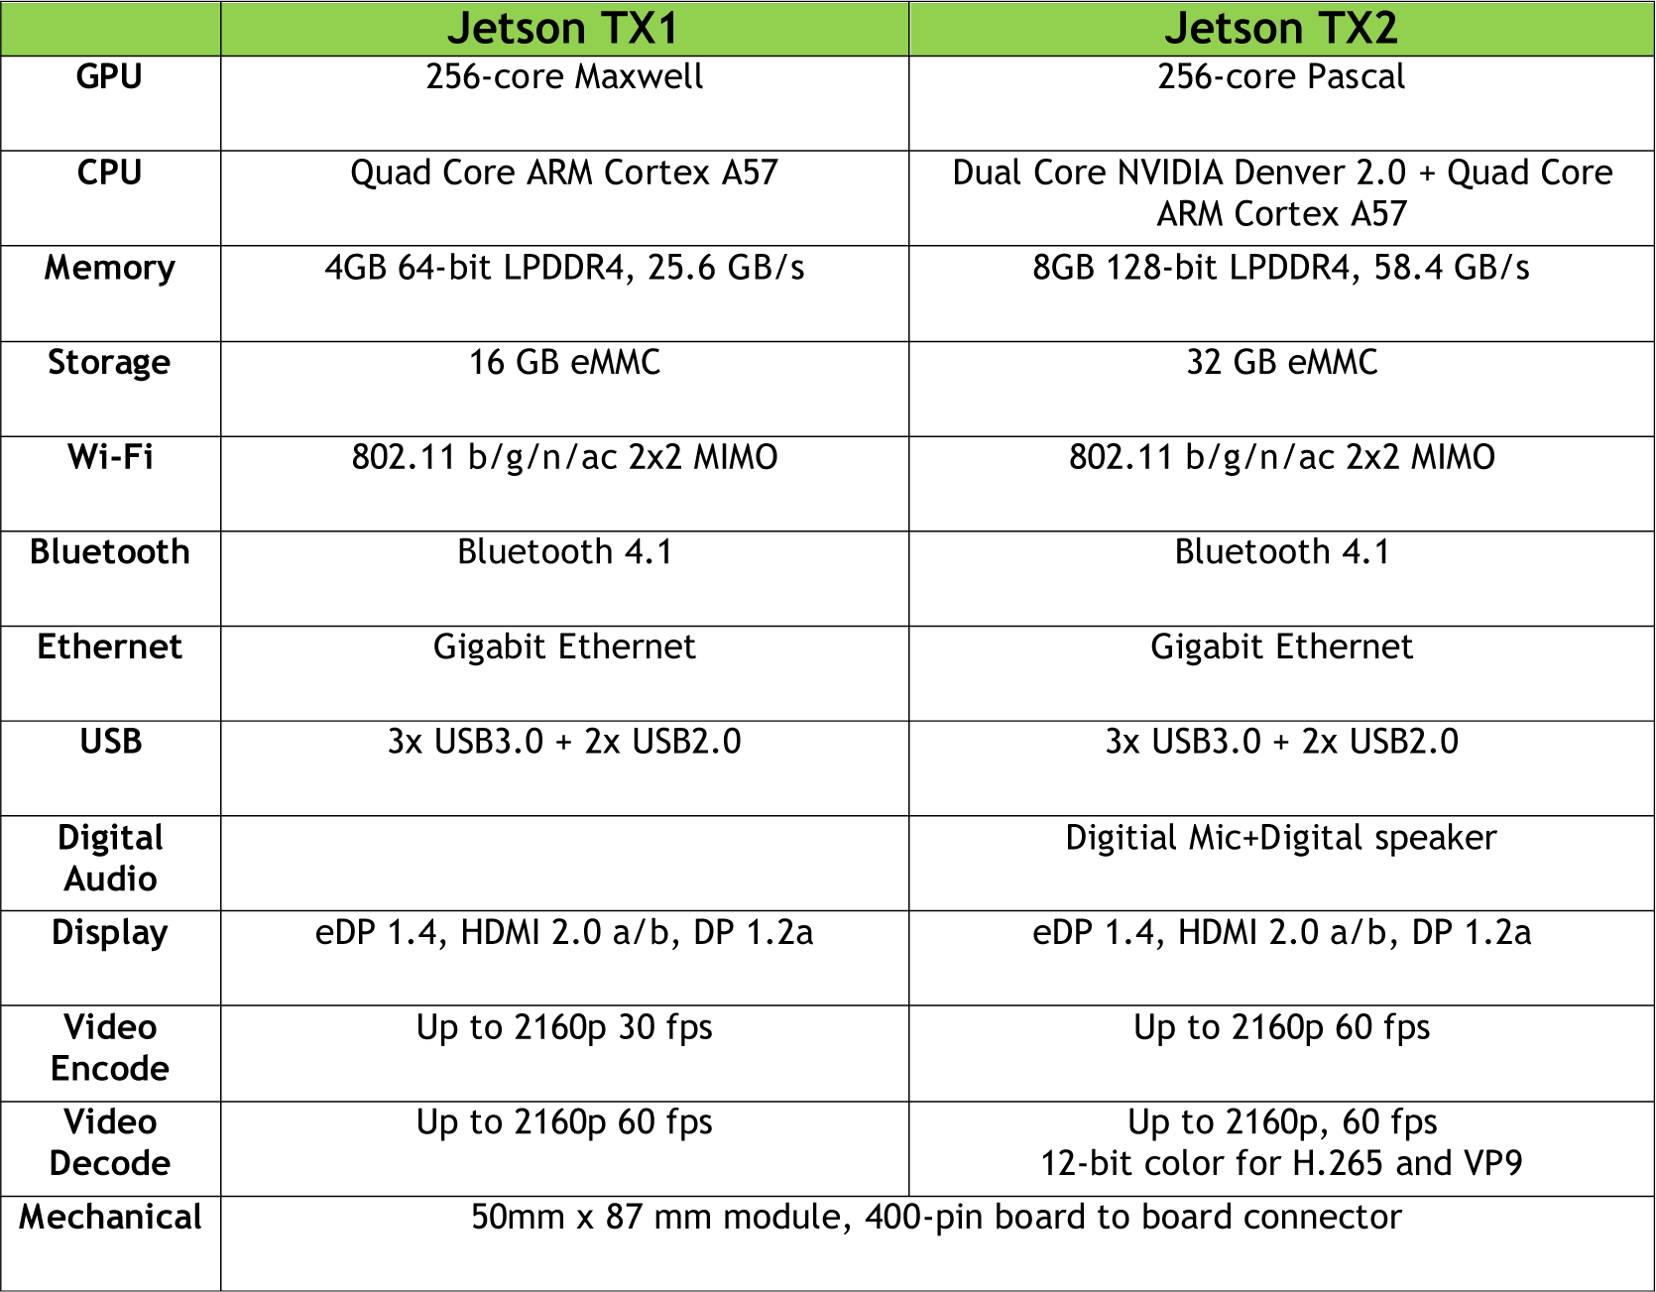
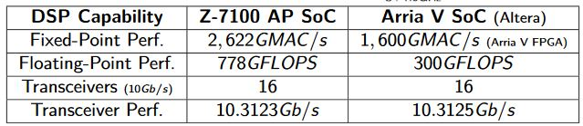
https://www.xilinx.com/products/boards-and-kits/board-functions/nav-embedded-processing.html
Xilinx Zynq-7000 All Programmable SoC ZC706 Evaluation Kit
The Zynq-7000 SoC ZC706 Evaluation Kit includes all the basic components to enable a complete embedded processing platform and Transceiver based designs, including PCIe. $2,495
XC7Z045 FFG900 – 2
Dual-core ARM Cortex-A9 MPCore™ with CoreSight™
DDR3 1GB + DDR3 SODIM 1GB
2X16MB Quad SPI Flash
SD Card Slot
FMC LPC
FMC HPC
Dual & Single Pmod
Gigabit Ethernet
USB OTG 1 (PS)
USB UART (PS)
PCIe Gen2x4
HDMI IN & OUT
No audio
AMS interface

